Slide 1
Introduction to Machine Learning
2012-05-15
Lars Marius Garshol, larsga@bouvet.no, http://twitter.com/larsga

Slide 2
Agenda
Introduction
Theory
Top 10 algorithms
Recommendations
Classification with naïve Bayes
Linear regression
Clustering
Principal Component Analysis
MapReduce
Conclusion

Slide 3
The code
I’ve put the Python source code for the examples on Github
Can be found at
https://github.com/larsga/py-snippets/tree/master/machine-learning/

Slide 4
Introduction

Slide 5
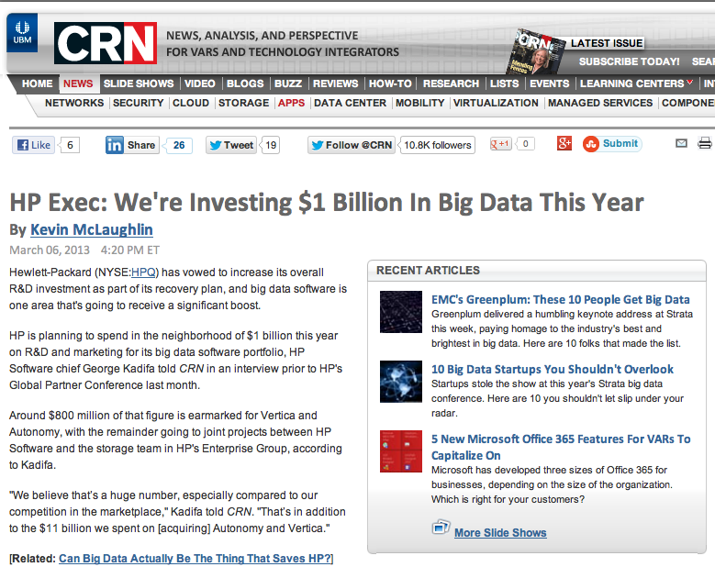

Slide 6
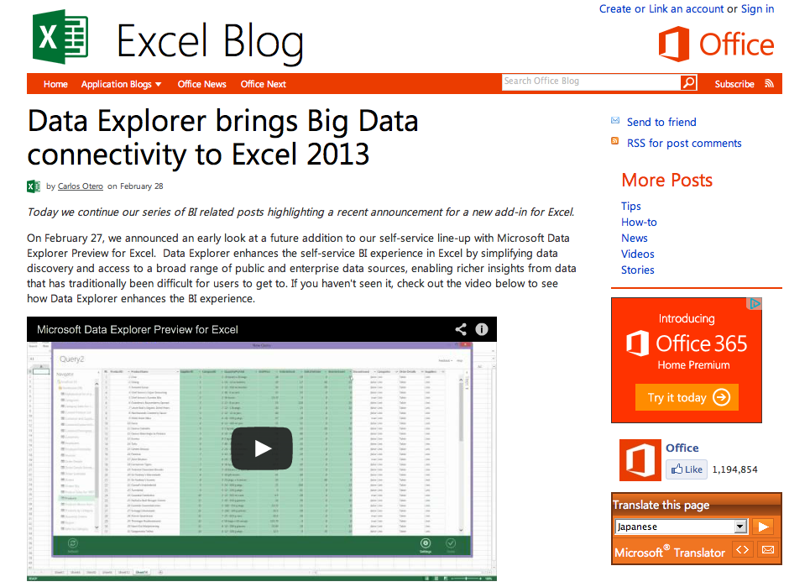

Slide 7

What is big data?
Big Data is any thing which is crash Excel.
Small Data is when is fit in RAM. Big Data is when is crash because is not fit in RAM.
Or, in other words, Big Data is data
in volumes too great to process by
traditional methods.
https://twitter.com/devops_borat

Slide 8
Data accumulation
Today, data is accumulating at tremendous rates
click streams from web visitors
supermarket transactions
sensor readings
video camera footage
GPS trails
social media interactions
...
It really is becoming a challenge to store and process it all in a meaningful way

Slide 9
From WWW to VVV
Volume
data volumes are becoming unmanageable
Variety
data complexity is growing
more types of data captured than previously
Velocity
some data is arriving so rapidly that it must either be processed instantly, or lost
this is a whole subfield called “stream processing”

Slide 10
The promise of Big Data
Data contains information of great business value
If you can extract those insights you can make far better decisions
...but is data really that valuable?

Slide 11


Slide 12
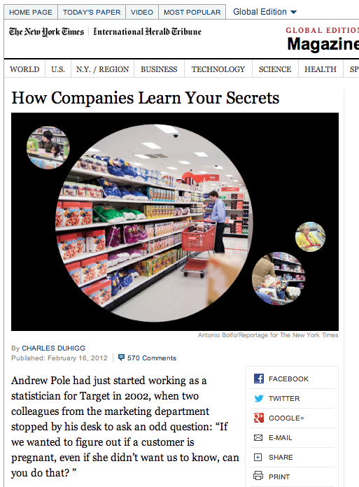
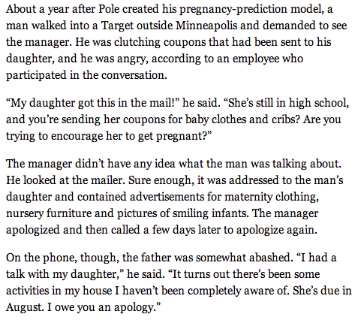

Slide 13
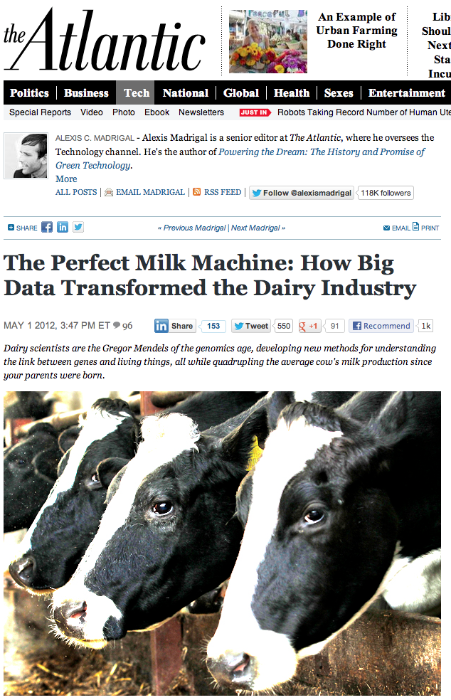
“quadrupling the average cow's milk production since your parents were born”
"When Freddie [as he is known] had no daughter records our equations predicted from his DNA that he would be the best bull," USDA research geneticist Paul VanRaden emailed me with a detectable hint of pride. "Now he is the best progeny tested bull (as predicted)."

Slide 14
Some more examples
Sports
basketball increasingly driven by data analytics
soccer beginning to follow
Entertainment
House of Cards designed based on data analysis
increasing use of similar tools in Hollywood
“Visa Says Big Data Identifies Billions of Dollars in Fraud”
new Big Data analytics platform on Hadoop
“Facebook is about to launch Big Data play”
starting to connect Facebook with real life
https://delicious.com/larsbot/big-data

Slide 15
Ok, ok, but ... does it apply to our customers?
Norwegian Food Safety Authority
accumulates data on all farm animals
birth, death, movements, medication, samples, ...
Hafslund
time series from hydroelectric dams, power prices, meters of individual customers, ...
Social Security Administration
data on individual cases, actions taken, outcomes...
Statoil
massive amounts of data from oil exploration, operations, logistics, engineering, ...
Retailers
see Target example above
also, connection between what people buy, weather forecast, logistics, ...

Slide 16
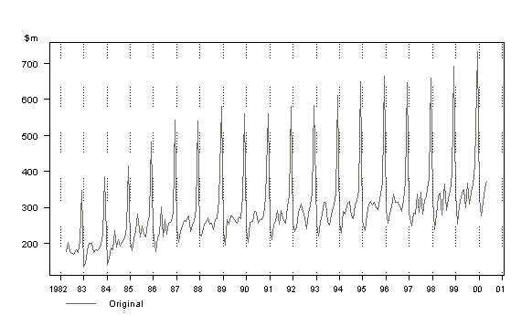
How to extract insight from data?
Monthly Retail Sales in New South Wales (NSW) Retail Department Stores

Slide 17
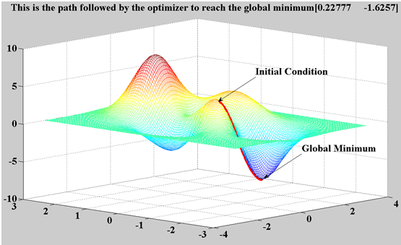
Types of algorithms
Clustering
Association learning
Parameter estimation
Recommendation engines
Classification
Similarity matching
Neural networks
Bayesian networks
Genetic algorithms

Slide 18
Basically, it’s all maths...
Linear algebra
Calculus
Probability theory
Graph theory
...
Only 10% in devops are know how of work with Big Data. Only 1% are realize they are need 2 Big Data for fault tolerance
18
https://twitter.com/devops_borat

Slide 19

Big data skills gap
Hardly anyone knows this stuff
It’s a big field, with lots and lots of theory
And it’s all maths, so it’s tricky to learn
http://www.ibmbigdatahub.com/blog/addressing-big-data-skills-gap
http://wikibon.org/wiki/v/Big_Data:_Hadoop,_Business_Analytics_and_Beyond#The_Big_Data_Skills_Gap

Slide 20

Two orthogonal aspects
Analytics / machine learning
learning insights from data
Big data
handling massive data volumes
Can be combined, or used separately

Slide 21

Data science?
http://drewconway.com/zia/2013/3/26/the-data-science-venn-diagram

Slide 22
How to process Big Data?
If relational databases are not enough, what is?
Mining of Big Data is problem solve in 2013 with zgrep
https://twitter.com/devops_borat

Slide 23
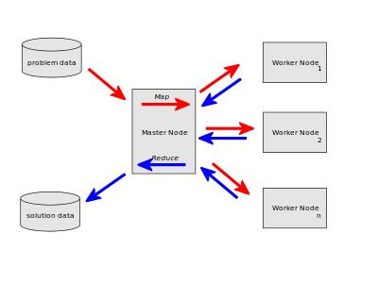

MapReduce
A framework for writing massively parallel code
Simple, straightforward model
Based on “map” and “reduce” functions from functional programming (LISP)

Slide 24
NoSQL and Big Data
Not really that relevant
Traditional databases handle big data sets, too
NoSQL databases have poor analytics
MapReduce often works from text files
can obviously work from SQL and NoSQL, too
NoSQL is more for high throughput
basically, AP from the CAP theorem, instead of CP
In practice, really Big Data is likely to be a mix
text files, NoSQL, and SQL

Slide 25
The 4th V: Veracity
“The greatest enemy of knowledge is not ignorance, it is the illusion of knowledge.”
Daniel Borstin, in The Discoverers (1983)
95% of time, when is clean Big Data is get Little Data
https://twitter.com/devops_borat

Slide 26
Data quality
A huge problem in practice
any manually entered data is suspect
most data sets are in practice deeply problematic
Even automatically gathered data can be a problem
systematic problems with sensors
errors causing data loss
incorrect metadata about the sensor
Never, never, never trust the data without checking it!
garbage in, garbage out, etc

Slide 27
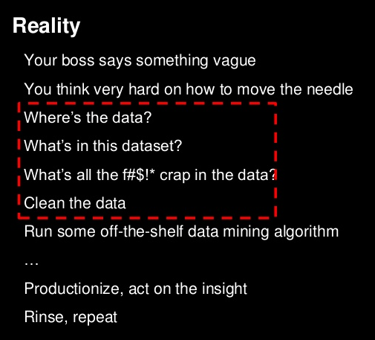
http://www.slideshare.net/Hadoop_Summit/scaling-big-data-mining-infrastructure-twitter-experience/12

Slide 28
Conclusion
Vast potential
to both big data and machine learning
Very difficult to realize that potential
requires mathematics, which nobody knows
We need to wake up!

Slide 29
Theory

Slide 30
Two kinds of learning
Supervised
we have training data with correct answers
use training data to prepare the algorithm
then apply it to data without a correct answer
Unsupervised
no training data
throw data into the algorithm, hope it makes some kind of sense out of the data

Slide 31
Some types of algorithms
Prediction
predicting a variable from data
Classification
assigning records to predefined groups
Clustering
splitting records into groups based on similarity
Association learning
seeing what often appears together with what

Slide 32
Issues
Data is usually noisy in some way
imprecise input values
hidden/latent input values
Inductive bias
basically, the shape of the algorithm we choose
may not fit the data at all
may induce underfitting or overfitting
Machine learning without inductive bias is not possible

Slide 33
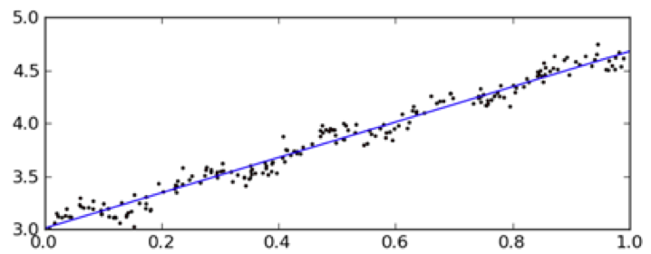
Underfitting
Using an algorithm that cannot capture the full complexity of the data

Slide 34
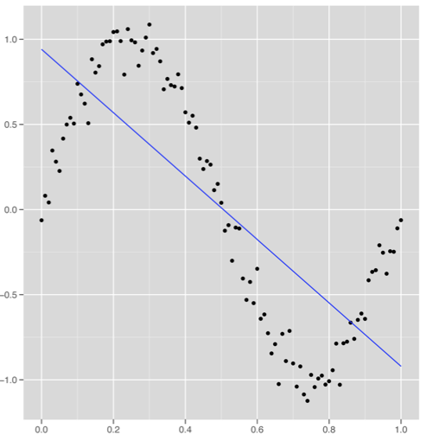
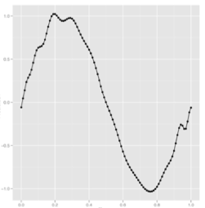
Overfitting
Tuning the algorithm so carefully it starts matching the noise in the training data

Slide 35
“What if the knowledge and data we have are not sufficient to completely determine the correct classifier? Then we run the risk of just hallucinating a classifier (or parts of it) that is not grounded in reality, and is simply encoding random quirks in the data. This problem is called overfitting, and is the bugbear of machine learning. When your learner outputs a classifier that is 100% accurate on the training data but only 50% accurate on test data, when in fact it could have output one that is 75% accurate on both, it has overfit.”
http://homes.cs.washington.edu/~pedrod/papers/cacm12.pdf

Slide 36
Testing
When doing this for real, testing is crucial
Testing means splitting your data set
training data (used as input to algorithm)
test data (used for evaluation only)
Need to compute some measure of performance
precision/recall
root mean square error
A huge field of theory here
will not go into it in this course
very important in practice

Slide 37
Missing values
Usually, there are missing values in the data set
that is, some records have some NULL values
These cause problems for many machine learning algorithms
Need to solve somehow
remove all records with NULLs
use a default value
estimate a replacement value
...

Slide 38
Terminology
Vector
one-dimensional array
Matrix
two-dimensional array
Linear algebra
algebra with vectors and matrices
addition, multiplication, transposition, ...

Slide 39
Top 10 algorithms

Slide 40
Top 10 machine learning algs
C4.5 No
k-means clustering Yes
Support vector machines No
the Apriori algorithm No
the EM algorithm No
PageRank No
AdaBoost No
k-nearest neighbours class. Kind of
Naïve Bayes Yes
CART No
From a survey at IEEE International Conference on Data Mining (ICDM) in December 2006. “Top 10 algorithms in data mining”, by X. Wu et al

Slide 41
C4.5
Algorithm for building decision trees
basically trees of boolean expressions
each node split the data set in two
leaves assign items to classes
Decision trees are useful not just for classification
they can also teach you something about the classes
C4.5 is a bit involved to learn
the ID3 algorithm is much simpler
CART (#10) is another algorithm for learning decision trees

Slide 42
Support Vector Machines
A way to do binary classification on matrices
Support vectors are the data points nearest to the hyperplane that divides the classes
SVMs maximize the distance between SVs and the boundary
Particularly valuable because of “the kernel trick”
using a transformation to a higher dimension to handle more complex class boundaries
A bit of work to learn, but manageable

Slide 43
Apriori
An algorithm for “frequent itemsets”
basically, working out which items frequently appear together
for example, what goods are often bought together in the supermarket?
used for Amazon’s “customers who bought this...”
Can also be used to find association rules
that is, “people who buy X often buy Y” or similar
Apriori is slow
a faster, further development is FP-growth
http://www.dssresources.com/newsletters/66.php

Slide 44
Expectation Maximization
A deeply interesting algorithm I’ve seen used in a number of contexts
very hard to understand what it does
very heavy on the maths
Essentially an iterative algorithm
skips between “expectation” step and “maximization” step
tries to optimize the output of a function
Can be used for
clustering
a number of more specialized examples, too

Slide 45
PageRank
Basically a graph analysis algorithm
identifies the most prominent nodes
used for weighting search results on Google
Can be applied to any graph
for example an RDF data set
Basically works by simulating random walk
estimating the likelihood that a walker would be on a given node at a given time
actual implementation is linear algebra
The basic algorithm has some issues
“spider traps”
graph must be connected
straightforward solutions to these exist

Slide 46
AdaBoost
Algorithm for “ensemble learning”
That is, for combining several algorithms
and training them on the same data
Combining more algorithms can be very effective
usually better than a single algorithm
AdaBoost basically weights training samples
giving the most weight to those which are classified the worst

Slide 47
Recommendations

Slide 48
Collaborative filtering
Basically, you’ve got some set of items
these can be movies, books, beers, whatever
You’ve also got ratings from users
on a scale of 1-5, 1-10, whatever
Can you use this to recommend items to a user, based on their ratings?
if you use the connection between their ratings and other people’s ratings, it’s called collaborative filtering
other approaches are possible

Slide 49
Feature-based recommendation
Use user’s ratings of items
run an algorithm to learn what features of items the user likes
Can be difficult to apply because
requires detailed information about items
key features may not be present in data
Recommending music may be difficult, for example

Slide 50
A simple idea
If we can find ratings from people similar to you, we can see what they liked
the assumption is that you should also like it, since your other ratings agreed so well
You can take the average ratings of the k people most similar to you
then display the items with the highest averages
This approach is called k-nearest neighbours
it’s simple, computationally inexpensive, and works pretty well
there are, however, some tricks involved

Slide 51
MovieLens data
Three sets of movie rating data
real, anonymized data, from the MovieLens site
ratings on a 1-5 scale
Increasing sizes
100,000 ratings
1,000,000 ratings
10,000,000 ratings
Includes a bit of information about the movies
The two smallest data sets also contain demographic information about users
http://www.grouplens.org/node/73

Slide 52
Basic algorithm
Load data into rating sets
a rating set is a list of (movie id, rating) tuples
one rating set per user
Compare rating sets against the user’s rating set with a similarity function
pick the k most similar rating sets
Compute average movie rating within these k rating sets
Show movies with highest averages

Slide 53
Similarity functions
Minkowski distance
basically geometric distance, generalized to any number of dimensions
Pearson correlation coefficient
Vector cosine
measures angle between vectors
Root mean square error (RMSE)
square root of the mean of square differences between data values

Slide 54
Data I added
User ID | Movie ID | Rating | Title
6041 | 347 | 4 | Bitter Moon
6041 | 1680 | 3 | Sliding Doors
6041 | 229 | 5 | Death and the Maiden
6041 | 1732 | 3 | The Big Lebowski
6041 | 597 | 2 | Pretty Woman
6041 | 991 | 4 | Michael Collins
6041 | 1693 | 3 | Amistad
6041 | 1484 | 4 | The Daytrippers
6041 | 427 | 1 | Boxing Helena
6041 | 509 | 4 | The Piano
6041 | 778 | 5 | Trainspotting
6041 | 1204 | 4 | Lawrence of Arabia
6041 | 1263 | 5 | The Deer Hunter
6041 | 1183 | 5 | The English Patient
6041 | 1343 | 1 | Cape Fear
6041 | 260 | 1 | Star Wars
6041 | 405 | 1 | Highlander III
6041 | 745 | 5 | A Close Shave
6041 | 1148 | 5 | The Wrong Trousers
6041 | 1721 | 1 | Titanic
Note these. Later we’ll see Wallace &
Gromit popping up in recommendations.
This is the 1M data set
https://github.com/larsga/py-snippets/tree/master/machine-learning/movielens

Slide 55
Root Mean Square Error
This is a measure that’s often used to judge the quality of prediction
predicted value: x
actual value: y
For each pair of values, do
(y - x)²
Procedure
sum over all pairs,
divide by the number of values (to get average),
take the square root of that (to undo squaring)
We use the square because
that always gives us a positive number,
it emphasizes bigger deviations

Slide 56
RMSE in Python
def rmse(rating1, rating2):
sum = 0
count = 0
for (key, rating) in rating1.items():
if key in rating2:
sum += (rating2[key] - rating) ** 2
count += 1
if not count:
return 1000000 # no common ratings, so distance is huge
return sqrt(sum / float(count))

Slide 57
Output, k=3
===== User 0 ==================================================
User # 14 , distance: 0.0
Deer Hunter, The (1978) 5 YOUR: 5
===== User 1 ==================================================
User # 68 , distance: 0.0
Close Shave, A (1995) 5 YOUR: 5
===== User 2 ==================================================
User # 95 , distance: 0.0
Big Lebowski, The (1998) 3 YOUR: 3
===== RECOMMENDATIONS =============================================
Chicken Run (2000) 5.0
Auntie Mame (1958) 5.0
Muppet Movie, The (1979) 5.0
'Night Mother (1986) 5.0
Goldfinger (1964) 5.0
Children of Paradise (Les enfants du paradis) (1945) 5.0
Total Recall (1990) 5.0
Boys Don't Cry (1999) 5.0
Radio Days (1987) 5.0
Ideal Husband, An (1999) 5.0
Red Violin, The (Le Violon rouge) (1998) 5.0
Distance measure: RMSE
Obvious problem: ratings agree perfectly,
but there are too few common ratings. More
ratings mean greater chance of disagreement.

Slide 58
RMSE 2.0
def lmg_rmse(rating1, rating2):
max_rating = 5.0
sum = 0
count = 0
for (key, rating) in rating1.items():
if key in rating2:
sum += (rating2[key] - rating) ** 2
count += 1
if not count:
return 1000000 # no common ratings, so distance is huge
return sqrt(sum / float(count)) + (max_rating / count)

Slide 59
Output, k=3, RMSE 2.0
===== 0 ==================================================
User # 3320 , distance: 1.09225018729
Highlander III: The Sorcerer (1994) 1 YOUR: 1
Boxing Helena (1993) 1 YOUR: 1
Pretty Woman (1990) 2 YOUR: 2
Close Shave, A (1995) 5 YOUR: 5
Michael Collins (1996) 4 YOUR: 4
Wrong Trousers, The (1993) 5 YOUR: 5
Amistad (1997) 4 YOUR: 3
===== 1 ==================================================
User # 2825 , distance: 1.24880819811
Amistad (1997) 3 YOUR: 3
English Patient, The (1996) 4 YOUR: 5
Wrong Trousers, The (1993) 5 YOUR: 5
Death and the Maiden (1994) 5 YOUR: 5
Lawrence of Arabia (1962) 4 YOUR: 4
Close Shave, A (1995) 5 YOUR: 5
Piano, The (1993) 5 YOUR: 4
===== 2 ==================================================
User # 1205 , distance: 1.41068360252
Sliding Doors (1998) 4 YOUR: 3
English Patient, The (1996) 4 YOUR: 5
Michael Collins (1996) 4 YOUR: 4
Close Shave, A (1995) 5 YOUR: 5
Wrong Trousers, The (1993) 5 YOUR: 5
Piano, The (1993) 4 YOUR: 4
===== RECOMMENDATIONS ==================================================
Patriot, The (2000) 5.0
Badlands (1973) 5.0
Blood Simple (1984) 5.0
Gold Rush, The (1925) 5.0
Mission: Impossible 2 (2000) 5.0
Gladiator (2000) 5.0
Hook (1991) 5.0
Funny Bones (1995) 5.0
Creature Comforts (1990) 5.0
Do the Right Thing (1989) 5.0
Thelma & Louise (1991) 5.0
Much better choice of users
But all recommended movies are 5.0
Basically, if one user gave it 5.0, that’s
going to beat 5.0, 5.0, and 4.0
Clearly, we need to reward movies that
have more ratings somehow

Slide 60
Bayesian average
A simple weighted average that accounts for how many ratings there are
Basically, you take the set of ratings and add n extra “fake” ratings of the average value
So for movies, we use the average of 3.0
>>> avg([5.0], 2)
3.6666666666666665
>>> avg([5.0, 5.0], 2)
4.0
>>> avg([5.0, 5.0, 5.0], 2)
4.2
>>> avg([5.0, 5.0, 5.0, 5.0], 2)
4.333333333333333
(sum(numbers) + (3.0 * n))
float(len(numbers) + n)

Slide 61
With k=3
===== RECOMMENDATIONS ===============
Truman Show, The (1998) 4.2
Say Anything... (1989) 4.0
Jerry Maguire (1996) 4.0
Groundhog Day (1993) 4.0
Monty Python and the Holy Grail (1974) 4.0
Big Night (1996) 4.0
Babe (1995) 4.0
What About Bob? (1991) 3.75
Howards End (1992) 3.75
Winslow Boy, The (1998) 3.75
Shakespeare in Love (1998) 3.75
Not very good, but k=3 makes us
very dependent on those specific 3
users.

Slide 62
With k=10
Definitely better.
===== RECOMMENDATIONS ===============
Groundhog Day (1993) 4.55555555556
Annie Hall (1977) 4.4
One Flew Over the Cuckoo's Nest (1975) 4.375
Fargo (1996) 4.36363636364
Wallace & Gromit: The Best of Aardman Animation (1996) 4.33333333333
Do the Right Thing (1989) 4.28571428571
Princess Bride, The (1987) 4.28571428571
Welcome to the Dollhouse (1995) 4.28571428571
Wizard of Oz, The (1939) 4.25
Blood Simple (1984) 4.22222222222
Rushmore (1998) 4.2

Slide 63
With k=50
===== RECOMMENDATIONS ===============
Wallace & Gromit: The Best of Aardman Animation (1996) 4.55
Roger & Me (1989) 4.5
Waiting for Guffman (1996) 4.5
Grand Day Out, A (1992) 4.5
Creature Comforts (1990) 4.46666666667
Fargo (1996) 4.46511627907
Godfather, The (1972) 4.45161290323
Raising Arizona (1987) 4.4347826087
City Lights (1931) 4.42857142857
Usual Suspects, The (1995) 4.41666666667
Manchurian Candidate, The (1962) 4.41176470588

Slide 64
With k = 2,000,000
If we did that, what results would we get?

Slide 65
Normalization
People use the scale differently
some give only 4s and 5s
others give only 1s
some give only 1s and 5s
etc
Should have normalized user ratings before using them
before comparison
and before averaging ratings from neighbours

Slide 66
Naïve Bayes

Slide 67
Bayes’s Theorem
Basically a theorem for combining probabilities
I’ve observed A, which indicates H is true with probability 70%
I’ve also observed B, which indicates H is true with probability 85%
what should I conclude?
Naïve Bayes is basically using this theorem
with the assumption that A and B are indepedent
this assumption is nearly always false, hence “naïve”

Slide 68
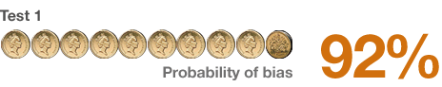
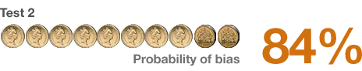
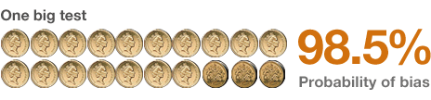
Simple example
Is the coin fair or not?
we throw it 10 times, get 9 heads and one tail
we try again, get 8 heads and two tails
What do we know now?
can combine data and recompute
or just use Bayes’s Theorem directly
>>> compute_bayes([0.92, 0.84])
0.9837067209775967
http://www.bbc.co.uk/news/magazine-22310186

Slide 69
Ways I’ve used Bayes
Duke
record deduplication engine
estimate probability of duplicate for each property
combine probabilities with Bayes
Whazzup
news aggregator that finds relevant news
works essentially like spam classifier on next slide
Tine recommendation prototype
recommends recipes based on previous choices
also like spam classifier
Classifying expenses
using export from my bank
also like spam classifier

Slide 70
Bayes against spam
Take a set of emails, divide it into spam and non-spam (ham)
count the number of times a feature appears in each of the two sets
a feature can be a word or anything you please
To classify an email, for each feature in it
consider the probability of email being spam given that feature to be (spam count) / (spam count + ham count)
ie: if “viagra” appears 99 times in spam and 1 in ham, the probability is 0.99
Then combine the probabilities with Bayes
http://www.paulgraham.com/spam.html

Slide 71
Running the script
I pass it
1000 emails from my Bouvet folder
1000 emails from my Spam folder
Then I feed it
1 email from another Bouvet folder
1 email from another Spam folder

Slide 72
Code
# scan spam
for spam in glob.glob(spamdir + '/' + PATTERN)[ : SAMPLES]:
for token in featurize(spam):
corpus.spam(token)
# scan ham
for ham in glob.glob(hamdir + '/' + PATTERN)[ : SAMPLES]:
for token in featurize(ham):
corpus.ham(token)
# compute probability
for email in sys.argv[3 : ]:
print email
p = classify(email)
if p < 0.2:
print ' Spam', p
else:
print ' Ham', p
https://github.com/larsga/py-snippets/tree/master/machine-learning/spam

Slide 73
Classify
class Feature:
def __init__(self, token):
self._token = token
self._spam = 0
self._ham = 0
def spam(self):
self._spam += 1
def ham(self):
self._ham += 1
def spam_probability(self):
return (self._spam + PADDING) / float(self._spam + self._ham + (PADDING * 2))
def compute_bayes(probs):
product = reduce(operator.mul, probs)
lastpart = reduce(operator.mul, map(lambda x: 1-x, probs))
if product + lastpart == 0:
return 0 # happens rarely, but happens
else:
return product / (product + lastpart)
def classify(email):
return compute_bayes([corpus.spam_probability(f) for f in featurize(email)])

Slide 74
Ham output
So, clearly most of the spam
is from March 2013...
Ham 1.0
Received:2013 0.00342935528121
Date:2013 0.00624219725343
<br 0.0291715285881
background-color: 0.03125
background-color: 0.03125
background-color: 0.03125
background-color: 0.03125
background-color: 0.03125
Received:Mar 0.0332667997339
Date:Mar 0.0362756952842
...
Postboks 0.998107494322
Postboks 0.998107494322
Postboks 0.998107494322
+47 0.99787414966
+47 0.99787414966
+47 0.99787414966
+47 0.99787414966
Lars 0.996863237139
Lars 0.996863237139
23 0.995381062356

Slide 75
Spam output
...and the ham from October 2012
Spam 2.92798502037e-16
Received:-0400 0.0115646258503
Received:-0400 0.0115646258503
Received-SPF:(ontopia.virtual.vps-host.net: 0.0135823429542
Received-SPF:receiver=ontopia.virtual.vps-host.net; 0.0135823429542
Received:<larsga@ontopia.net>; 0.0139318885449
Received:<larsga@ontopia.net>; 0.0139318885449
Received:ontopia.virtual.vps-host.net 0.0170863309353
Received:(8.13.1/8.13.1) 0.0170863309353
Received:ontopia.virtual.vps-host.net 0.0170863309353
Received:(8.13.1/8.13.1) 0.0170863309353
...
Received:2012 0.986111111111
Received:2012 0.986111111111
$ 0.983193277311
Received:Oct 0.968152866242
Received:Oct 0.968152866242
Date:2012 0.959459459459
20 0.938864628821
+ 0.936526946108
+ 0.936526946108
+ 0.936526946108

Slide 76
More solid testing
Using the SpamAssassin public corpus
Training with 500 emails from
spam
easy_ham (2002)
Test results
spam_2: 1128 spam, 269 misclassified as ham
easy_ham 2003: 2283 ham, 217 spam
Results are pretty good for 30 minutes of effort...
http://spamassassin.apache.org/publiccorpus/

Slide 77
Linear regression

Slide 78
Linear regression
Let’s say we have a number of numerical parameters for an object
We want to use these to predict some other value
Examples
estimating real estate prices
predicting the rating of a beer
...

Slide 79
Estimating real estate prices
Take parameters
x₁ square meters
x₂ number of rooms
x₃ number of floors
x₄ energy cost per year
x₅ meters to nearest subway station
x₆ years since built
x₇ years since last refurbished
...
a x₁ + b x₂ + c x₃ + ... = price
strip out the x-es and you have a vector
collect N samples of real flats with prices = matrix
welcome to the world of linear algebra

Slide 80

Our data set: beer ratings
Ratebeer.com
a web site for rating beer
scale of 0.5 to 5.0
For each beer we know
alcohol %
country of origin
brewery
beer style (IPA, pilsener, stout, ...)
But ... only one attribute is numeric!
how to solve?

Slide 81
Example
ABV | .se | .nl | .us | .uk | IIPA | Black IPA | Pale ale | Bitter | Rating
8.5 | 1.0 | 0.0 | 0.0 | 0.0 | 1.0 | 0.0 | 0.0 | 0.0 | 3.5
8.0 | 0.0 | 1.0 | 0.0 | 0.0 | 0.0 | 1.0 | 0.0 | 0.0 | 3.7
6.2 | 0.0 | 0.0 | 1.0 | 0.0 | 0.0 | 0.0 | 1.0 | 0.0 | 3.2
4.4 | 0.0 | 0.0 | 0.0 | 1.0 | 0.0 | 0.0 | 0.0 | 1.0 | 3.2
... | ... | ... | ... | ... | ... | ... | ... | ... | ...
Basically, we turn each category into a column of 0.0 or 1.0 values.

Slide 82
Normalization
If some columns have much bigger values than the others they will automatically dominate predictions
We solve this by normalization
Basically, all values get resized into the 0.0-1.0 range
For ABV we set a ceiling of 15%
compute with min(15.0, abv) / 15.0

Slide 83
Adding more data
To get a bit more data, I added manually a description of each beer style
Each beer style got a 0.0-1.0 rating on
colour (pale/dark)
sweetness
hoppiness
sourness
These ratings are kind of coarse because all beers of the same style get the same value

Slide 84
Making predictions
We’re looking for a formula
a * abv + b * .se + c * .nl + d * .us + ... = rating
We have n examples
a * 8.5 + b * 1.0 + c * 0.0 + d * 0.0 + ... = 3.5
We have one unknown per column
as long as we have more rows than columns we can solve the equation
Interestingly, matrix operations can be used to solve this easily

Slide 85
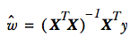
Matrix formulation
Let’s say
x is our data matrix
y is a vector with the ratings and
w is a vector with the a, b, c, ... values
That is: x * w = y
this is the same as the original equation
a x₁ + b x₂ + c x₃ + ... = rating
If we solve this, we get

Slide 86
Enter Numpy
Numpy is a Python library for matrix operations
It has built-in types for vectors and matrices
Means you can very easily work with matrices in Python
Why matrices?
much easier to express what we want to do
library written in C and very fast
takes care of rounding errors, etc

Slide 87
Quick Numpy example
>>> from numpy import *
>>> range(10)
[0, 1, 2, 3, 4, 5, 6, 7, 8, 9]
>>> [range(10)] * 10
[[0, 1, 2, 3, 4, 5, 6, 7, 8, 9], [0, 1, 2, 3, 4, 5, 6, 7, 8, 9], [0, 1, 2, 3, 4, 5, 6, 7, 8, 9], [0, 1, 2, 3, 4, 5, 6, 7, 8, 9], [0, 1, 2, 3, 4, 5, 6, 7, 8, 9], [0, 1, 2, 3, 4, 5, 6, 7, 8, 9], [0, 1, 2, 3, 4, 5, 6, 7, 8, 9], [0, 1, 2, 3, 4, 5, 6, 7, 8, 9], [0, 1, 2, 3, 4, 5, 6, 7, 8, 9], [0, 1, 2, 3, 4, 5, 6, 7, 8, 9]]
>>> m = mat([range(10)] * 10)
>>> m
matrix([[0, 1, 2, 3, 4, 5, 6, 7, 8, 9],
[0, 1, 2, 3, 4, 5, 6, 7, 8, 9],
[0, 1, 2, 3, 4, 5, 6, 7, 8, 9],
[0, 1, 2, 3, 4, 5, 6, 7, 8, 9],
[0, 1, 2, 3, 4, 5, 6, 7, 8, 9],
[0, 1, 2, 3, 4, 5, 6, 7, 8, 9],
[0, 1, 2, 3, 4, 5, 6, 7, 8, 9],
[0, 1, 2, 3, 4, 5, 6, 7, 8, 9],
[0, 1, 2, 3, 4, 5, 6, 7, 8, 9],
[0, 1, 2, 3, 4, 5, 6, 7, 8, 9]])
>>> m.T
matrix([[0, 0, 0, 0, 0, 0, 0, 0, 0, 0],
[1, 1, 1, 1, 1, 1, 1, 1, 1, 1],
[2, 2, 2, 2, 2, 2, 2, 2, 2, 2],
[3, 3, 3, 3, 3, 3, 3, 3, 3, 3],
[4, 4, 4, 4, 4, 4, 4, 4, 4, 4],
[5, 5, 5, 5, 5, 5, 5, 5, 5, 5],
[6, 6, 6, 6, 6, 6, 6, 6, 6, 6],
[7, 7, 7, 7, 7, 7, 7, 7, 7, 7],
[8, 8, 8, 8, 8, 8, 8, 8, 8, 8],
[9, 9, 9, 9, 9, 9, 9, 9, 9, 9]])

Slide 88
Numpy solution
We load the data into
a list: scores
a list of lists: parameters
Then:
x_mat = mat(parameters)
y_mat = mat(scores).T
x_tx = x_mat.T * x_mat
assert linalg.det(x_tx)
ws = x_tx.I * (x_mat.T * y_mat)

Slide 89
Does it work?
We only have very rough information about each beer (abv, country, style)
so very detailed prediction isn’t possible
but we should get some indication
Here are the results based on my ratings
10% imperial stout from US 3.9
4.5% pale lager from Ukraine 2.8
5.2% German schwarzbier 3.1
7.0% German doppelbock 3.5
http://www.ratebeer.com/user/15206/ratings/

Slide 90
Beyond prediction
We can use this for more than just prediction
We can also use it to see which columns contribute the most to the rating
that is, which aspects of a beer best predict the rating
If we look at the w vector we see the following
Aspect LMG grove
ABV 0.56 1.1
colour 0.46 0.42
sweetness 0.25 0.51
hoppiness 0.45 0.41
sourness 0.29 0.87
Could also use correlation

Slide 91
Did we underfit?
Who says the relationship between ABV and the rating is linear?
perhaps very low and very high ABV are both negative?
we cannot capture that with linear regression
Solution
add computed columns for parameters raised to higher powers
abv², abv³, abv⁴, ...
beware of overfitting...

Slide 92
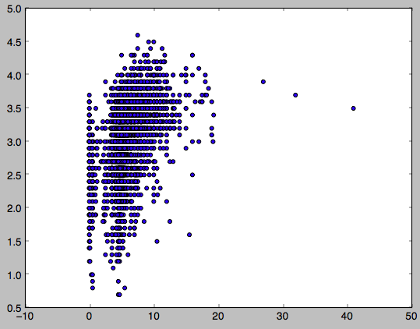
Scatter plot
Rating
Freeze-distilled Brewdog beers
Code in Github, requires matplotlib
ABV in %

Slide 93
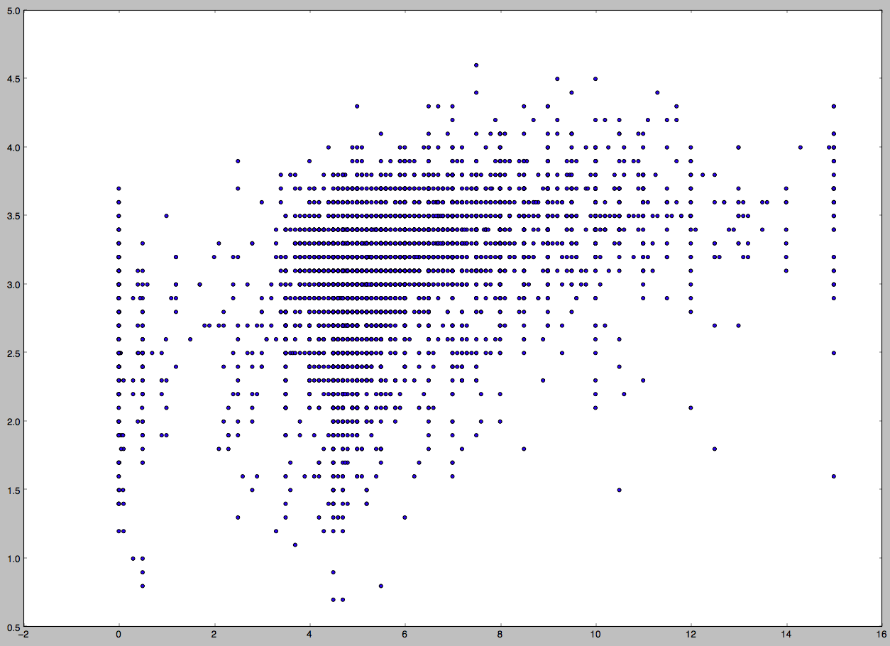
Trying again

Slide 94
Matrix factorization
Another way to do recommendations is matrix factorization
basically, make a user/item matrix with ratings
try to find two smaller matrices that, when multiplied together, give you the original matrix
that is, original with missing values filled in
Why that works?
I don’t know
I tried it, couldn’t get it to work
therefore we’re not covering it
known to be a very good method, however

Slide 95
Clustering

Slide 96
Clustering
Basically, take a set of objects and sort them into groups
objects that are similar go into the same group
The groups are not defined beforehand
Sometimes the number of groups to create is input to the algorithm
Many, many different algorithms for this

Slide 97
Sample data
Our sample data set is data about aircraft from DBpedia
For each aircraft model we have
name
length (m)
height (m)
wingspan (m)
number of crew members
operational ceiling, or max height (m)
max speed (km/h)
empty weight (kg)
We use a subset of the data
149 aircraft models which all have values for all of these properties
Also, all values normalized to the 0.0-1.0 range

Slide 98
Distance
All clustering algorithms require a distance function
that is, a measure of similarity between two objects
Any kind of distance function can be used
generally, lower values mean more similar
Examples of distance functions
metric distance
vector cosine
RMSE
...

Slide 99
k-means clustering
Input: the number of clusters to create (k)
Pick k objects
these are your initial clusters
For all objects, find nearest cluster
assign the object to that cluster
For each cluster, compute mean of all properties
use these mean values to compute distance to clusters
the mean is often referred to as a “centroid”
go back to previous step
Continue until no objects change cluster

Slide 100
First attempt at aircraft
We leave out name and number built when doing comparison
We use RMSE as the distance measure
We set k = 5
What happens?
first iteration: all 149 assigned to a cluster
second: 11 models change cluster
third: 7 change
fourth: 5 change
fifth: 5 change
sixth: 2
seventh: 1
eighth: 0

Slide 101
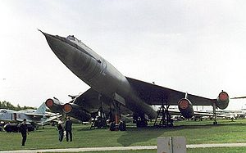


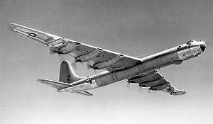
Cluster 5
cluster5, 4 models
ceiling : 13400.0
maxspeed : 1149.7
crew : 7.5
length : 47.275
height : 11.65
emptyweight : 69357.5
wingspan : 47.18
3 jet bombers, one
propeller bomber.
Not too bad.
The Myasishchev M-50 was a Soviet prototype four-engine supersonic bomber which never attained service
The Myasishchev M-4 Molot is a four-engined strategic bomber
The Convair B-36 "Peacemaker” was a strategic bomber built by Convair and operated solely by the United States Air Force (USAF) from 1949 to 1959
The Tupolev Tu-16 was a twin-engine jet bomber used by the Soviet Union.

Slide 102

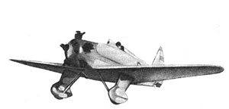
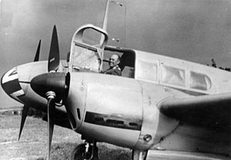



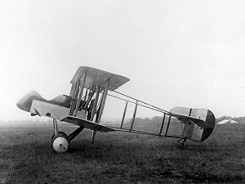
Cluster 4
Small, slow propeller aircraft.
Not too bad.
cluster4, 56 models
ceiling : 5898.2
maxspeed : 259.8
crew : 2.2
length : 10.0
height : 3.3
emptyweight : 2202.5
wingspan : 13.8
The Avia B.135 was a Czechoslovak cantilever monoplane fighter aircraft
The Yakovlev UT-1 was a single-seater trainer aircraft
The Siebel Fh 104 Hallore was a small German twin-engined transport, communications and liaison aircraft
The Yakovlev UT-2 was a single-seater trainer aircraft
The North American B-25 Mitchell was an American twin-engined medium bomber
The Airco DH.2 was a single-seat biplane "pusher" aircraft
The Messerschmitt Bf 108 Taifun was a German single-engine sports and touring aircraft

Slide 103






Cluster 3
Small, very fast jet planes. Pretty good.
cluster3, 12 models
ceiling : 16921.1
maxspeed : 2456.9
crew : 2.67
length : 17.2
height : 4.92
emptyweight : 9941
wingspan : 10.1
The Mikoyan MiG-29 is a fourth-generation jet fighter aircraft
The English Electric Lightning is a supersonic jet fighter aircraft of the Cold War era, noted for its great speed.
The Northrop T-38 Talon is a two-seat, twin-engine supersonic jet trainer
The Vought F-8 Crusader was a single-engine, supersonic [fighter] aircraft
The Dassault Mirage 5 is a supersonic attack aircraft
The Mikoyan MiG-35 is a further development of the MiG-29

Slide 104

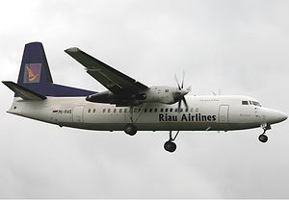
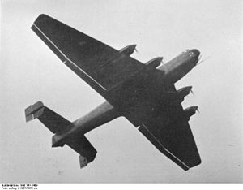
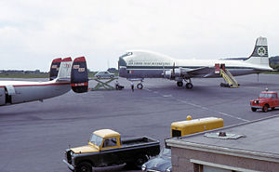
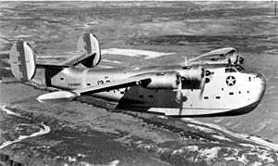
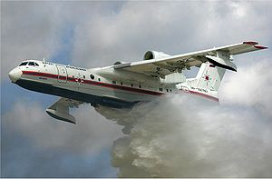
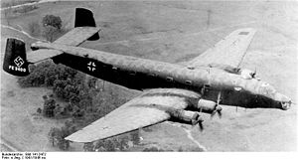
Cluster 2
Biggish, kind of slow planes.
Some oddballs in this group.
cluster2, 27 models
ceiling : 6447.5
maxspeed : 435
crew : 5.4
length : 24.4
height : 6.7
emptyweight : 16894
wingspan : 32.8
The Bartini Beriev VVA-14 (vertical take-off amphibious aircraft)
The Fokker 50 is a turboprop-powered airliner
The Junkers Ju 89 was a heavy bomber
The Aviation Traders ATL-98 Carvair was a large piston-engine transport aircraft.
The PB2Y Coronado was a large flying boat patrol bomber
The Beriev Be-200 Altair is a multipurpose amphibious aircraft
The Junkers Ju 290 was a long-range transport, maritime patrol aircraft and heavy bomber

Slide 105
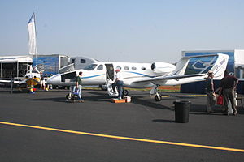


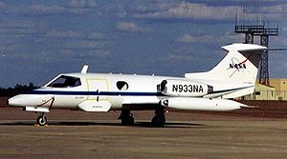
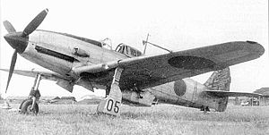

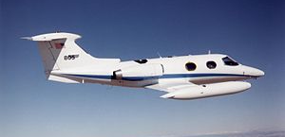
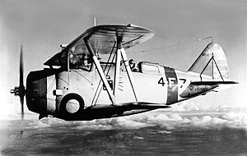
Cluster 1
Small, fast planes. Mostly good, though the Canberra is a poor fit.
cluster1, 50 models
ceiling : 11612
maxspeed : 726.4
crew : 1.6
length : 11.9
height : 3.8
emptyweight : 5303
wingspan : 13
The Adam A700 AdamJet was a proposed six-seat civil utility aircraft
The Curtiss P-36 Hawk was an American-designed and built fighter aircraft
The English Electric Canberra is a first-generation jet-powered light bomber
The Heinkel He 100 was a German pre-World War II fighter aircraft
The Learjet 23 is a ... twin-engine, high-speed business jet
The Kawasaki Ki-61 Hien was a Japanese World War II fighter aircraft
The Learjet 24 is a ... twin-engine, high-speed business jet
The Grumman F3F was the last American biplane fighter aircraft

Slide 106
Clusters, summarizing
Cluster 1: small, fast aircraft (750 km/h)
Cluster 2: big, slow aircraft (450 km/h)
Cluster 3: small, very fast jets (2500 km/h)
Cluster 4: small, very slow planes (250 km/h)
Cluster 5: big, fast jet planes (1150 km/h)
For a first attempt to sort through the data,
this is not bad at all
https://github.com/larsga/py-snippets/tree/master/machine-learning/aircraft

Slide 107
Agglomerative clustering
Put all objects in a pile
Make a cluster of the two objects closest to one another
from here on, treat clusters like objects
Repeat second step until satisfied
There is code for this, too, in the Github sample

Slide 108
Principal component analysis

Slide 109
PCA
Basically, using eigenvalue analysis to find out which variables contain the most information
the maths are pretty involved
and I’ve forgotten how it works
and I’ve thrown out my linear algebra book
and ordering a new one from Amazon takes too long
...so we’re going to do this intuitively

Slide 110
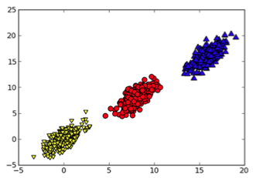
An example data set
Two variables
Three classes
What’s the longest line we could draw through the data?
That line is a vector in two dimensions
What dimension dominates?
that’s right: the horizontal
this implies the horizontal contains most of the information in the data set
PCA identifies the most significant variables

Slide 111
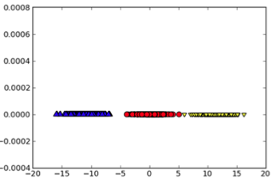
Dimensionality reduction
After PCA we know which dimensions matter
based on that information we can decide to throw out less important dimensions
Result
smaller data set
faster computations
easier to understand

Slide 112
Trying out PCA
Let’s try it on the Ratebeer data
We know ABV has the most information
because it’s the only value specified for each individual beer
We also include a new column: alcohol
this is the amount of alcohol in a pint glass of the beer, measured in centiliters
this column basically contains no information at all; it’s computed from the abv column

Slide 113
Complete code
import rblib
from numpy import *
def eigenvalues(data, columns):
covariance = cov(data - mean(data, axis = 0), rowvar = 0)
eigvals = linalg.eig(mat(covariance))[0]
indices = list(argsort(eigvals))
indices.reverse() # so we get most significant first
return [(columns[ix], float(eigvals[ix])) for ix in indices]
(scores, parameters, columns) = rblib.load_as_matrix('ratings.txt')
for (col, ev) in eigenvalues(parameters, columns):
print "%40s %s" % (col, float(ev))

Slide 114
Output
abv 0.184770392185
colour 0.13154093951
sweet 0.121781685354
hoppy 0.102241100597
sour 0.0961537687655
alcohol 0.0893502031589
United States 0.0677552513387
....
Eisbock -3.73028421245e-18
Belarus -3.73028421245e-18
Vietnam -1.68514561515e-17

Slide 115
MapReduce

Slide 116
University pre-lecture, 1991
My first meeting with university was Open University Day, in 1991
Professor Bjørn Kirkerud gave the computer science talk
His subject
some day processors will stop becoming faster
we’re already building machines with many processors
what we need is a way to parallelize software
preferably automatically, by feeding in normal source code and getting it parallelized back
MapReduce is basically the state of the art on that today

Slide 117
MapReduce
A framework for writing massively parallel code
Simple, straightforward model
Based on “map” and “reduce” functions from functional programming (LISP)

Slide 118
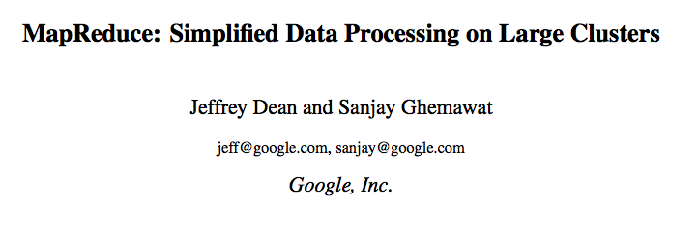
http://research.google.com/archive/mapreduce.html
Appeared in:
OSDI'04: Sixth Symposium on Operating System Design and Implementation,
San Francisco, CA, December, 2004.

Slide 119
map and reduce
>>> "1 2 3 4 5 6 7 8".split()
['1', '2', '3', '4', '5', '6', '7', '8']
>>> l = map(int, "1 2 3 4 5 6 7 8".split())
>>> l
[1, 2, 3, 4, 5, 6, 7, 8]
>>> import operator
>>> reduce(operator.add, l)
36

Slide 120
MapReduce
Split data into fragments
Create a Map task for each fragment
the task outputs a set of (key, value) pairs
Group the pairs by key
Call Reduce once for each key
all pairs with same key passed in together
reduce outputs new (key, value) pairs
Tasks get spread out over worker nodes
Master node keeps track of completed/failed tasks
Failed tasks are restarted
Failed nodes are detected and avoided
Also scheduling tricks to deal with slow nodes

Slide 121
Communications
HDFS
Hadoop Distributed File System
input data, temporary results, and results are stored as files here
Hadoop takes care of making files available to nodes
Hadoop RPC
how Hadoop communicates between nodes
used for scheduling tasks, heartbeat etc
Most of this is in practice hidden from the developer

Slide 122
Does anyone need MapReduce?
I tried to do book recommendations with linear algebra
Basically, doing matrix multiplication to produce the full user/item matrix with blanks filled in
My Mac wound up freezing
185,973 books x 77,805 users = 14,469,629,265
assuming 2 bytes per float = 28 GB of RAM
So it doesn’t necessarily take that much to have some use for MapReduce

Slide 123
The word count example
Classic example of using MapReduce
Takes an input directory of text files
Processes them to produce word frequency counts
To start up, copy data into HDFS
bin/hadoop dfs -mkdir <hdfs-dir>
bin/hadoop dfs -copyFromLocal <local-dir> <hdfs-dir>

Slide 124
WordCount – the mapper
public static class Map extends Mapper<LongWritable, Text, Text, IntWritable> {
private final static IntWritable one = new IntWritable(1);
private Text word = new Text();
public void map(LongWritable key, Text value, Context context) {
String line = value.toString();
StringTokenizer tokenizer = new StringTokenizer(line);
while (tokenizer.hasMoreTokens()) {
word.set(tokenizer.nextToken());
context.write(word, one);
}
}
}
By default, Hadoop will scan all text files in input directory
Each line in each file will become a mapper task
And thus a “Text value” input to a map() call

Slide 125
WordCount – the reducer
public static class Reduce extends Reducer<Text, IntWritable, Text, IntWritable> {
public void reduce(Text key, Iterable<IntWritable> values, Context context) {
int sum = 0;
for (IntWritable val : values)
sum += val.get();
context.write(key, new IntWritable(sum));
}
}

Slide 126
The Hadoop ecosystem
Pig
dataflow language for setting up MR jobs
HBase
NoSQL database to store MR input in
Hive
SQL-like query language on top of Hadoop
Mahout
machine learning library on top of Hadoop
Hadoop Streaming
utility for writing mappers and reducers as command-line tools in other languages

Slide 127
Word count in HiveQL
CREATE TABLE input (line STRING);
LOAD DATA LOCAL INPATH 'input.tsv' OVERWRITE INTO TABLE input;
-- temporary table to hold words...
CREATE TABLE words (word STRING);
add file splitter.py;
INSERT OVERWRITE TABLE words
SELECT TRANSFORM(text)
USING 'python splitter.py'
AS word
FROM input;
SELECT word, COUNT(*)
FROM input
LATERAL VIEW explode(split(text, ' ')) lTable as word
GROUP BY word;

Slide 128
Word count in Pig
input_lines = LOAD '/tmp/my-copy-of-all-pages-on-internet' AS (line:chararray);
-- Extract words from each line and put them into a pig bag
-- datatype, then flatten the bag to get one word on each row
words = FOREACH input_lines GENERATE FLATTEN(TOKENIZE(line)) AS word;
-- filter out any words that are just white spaces
filtered_words = FILTER words BY word MATCHES '\\w+';
-- create a group for each word
word_groups = GROUP filtered_words BY word;
-- count the entries in each group
word_count = FOREACH word_groups GENERATE COUNT(filtered_words) AS count, group AS word;
-- order the records by count
ordered_word_count = ORDER word_count BY count DESC;
STORE ordered_word_count INTO '/tmp/number-of-words-on-internet';

Slide 129
Applications of MapReduce
Linear algebra operations
easily mapreducible
SQL queries over heterogeneous data
basically requires only a mapping to tables
relational algebra easy to do in MapReduce
PageRank
basically one big set of matrix multiplications
the original application of MapReduce
Recommendation engines
the SON algorithm
...

Slide 130

Apache Mahout
Has three main application areas
others are welcome, but this is mainly what’s there now
Recommendation engines
several different similarity measures
collaborative filtering
Slope-one algorithm
Clustering
k-means and fuzzy k-means
Latent Dirichlet Allocation
Classification
stochastic gradient descent
Support Vector Machines
Naïve Bayes

Slide 131
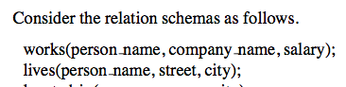
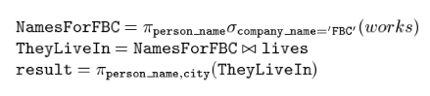
SQL to relational algebra
select lives.person_name, city
from works, lives where company_name = ’FBC’ and
works.person_name = lives.person_name

Slide 132
Translation to MapReduce
σ(company_name=‘FBC’, works)
map: for each record r in works, verify the condition, and pass (r, r) if it matches
reduce: receive (r, r) and pass it on unchanged
π(person_name, σ(...))
map: for each record r in input, produce a new record r’ with only wanted columns, pass (r’, r’)
reduce: receive (r’, [r’, r’, r’ ...]), output (r’, r’)
⋈(π(...), lives)
map:
for each record r in π(...), output (person_name, r)
for each record r in lives, output (person_name, r)
reduce: receive (key, [record, record, ...]), and perform the actual join
...

Slide 133
Lots of SQL-on-MapReduce tools
Tenzing Google
Hive Apache Hadoop
YSmart Ohio State
SQL-MR AsterData
HadoopDB Hadapt
Polybase Microsoft
RainStor RainStor Inc.
ParAccel ParAccel Inc.
Impala Cloudera
...

Slide 134
Conclusion

Slide 135
Big data & machine learning
This is a huge field, growing very fast
Many algorithms and techniques
can be seen as a giant toolbox with wide-ranging applications
Ranging from the very simple to the extremely sophisticated
Difficult to see the big picture
Huge range of applications
Math skills are crucial

Slide 136

https://www.coursera.org/course/ml

Slide 137
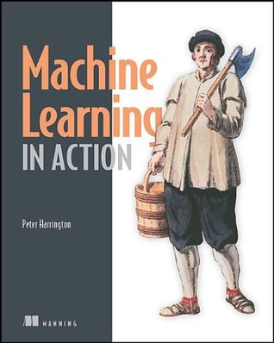
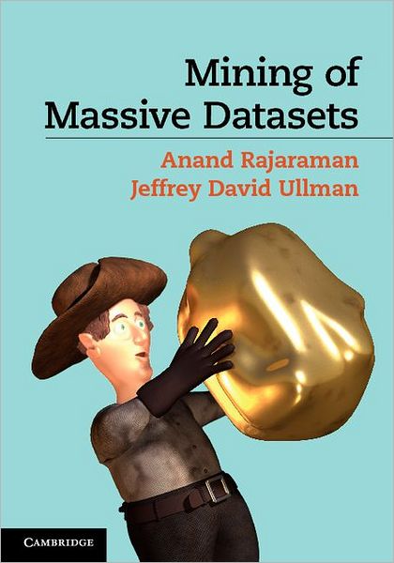
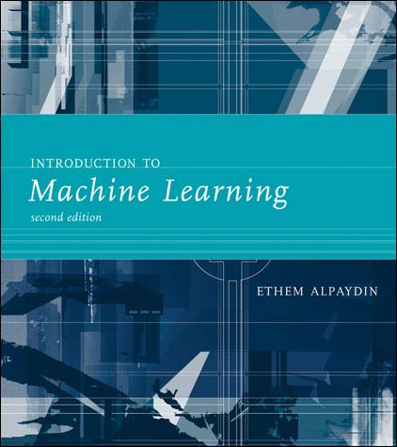
Books I recommend
http://infolab.stanford.edu/~ullman/mmds.html

